Slide 1

EXPLORING EMPLOYEE PERFORMANCE AND SATISFACTION IN HR EMPLOYEE DATASET
BY HARISH B
JUNE-DADS

Slide 2

WHAT? A collection of HR employee records with details on demographics, job roles, satisfaction, and performance.
WHAT WE ANALYZE?
To identify factors driving employee attrition and retention.
To understand links between salary, satisfaction, and job level.
WHAT WE SHOW?
Key drivers of employee attrition and performance.
Correlation between HR factors like income, age, and job level.

Slide 3

INTRODUCTION
Total Records
1,400+ employee records
Key Features
Age, Education, Job Role, Job Level, Monthly Income, Job Satisfaction, Environment Satisfaction, Job Involvement, Performance Rating, Years at Company, Number of Companies Worked
Employee Characteristics
Includes demographic details (age, education, experience)
Covers job-related aspects (role, level, income, satisfaction)
Information on performance, promotions, and work history

Slide 4
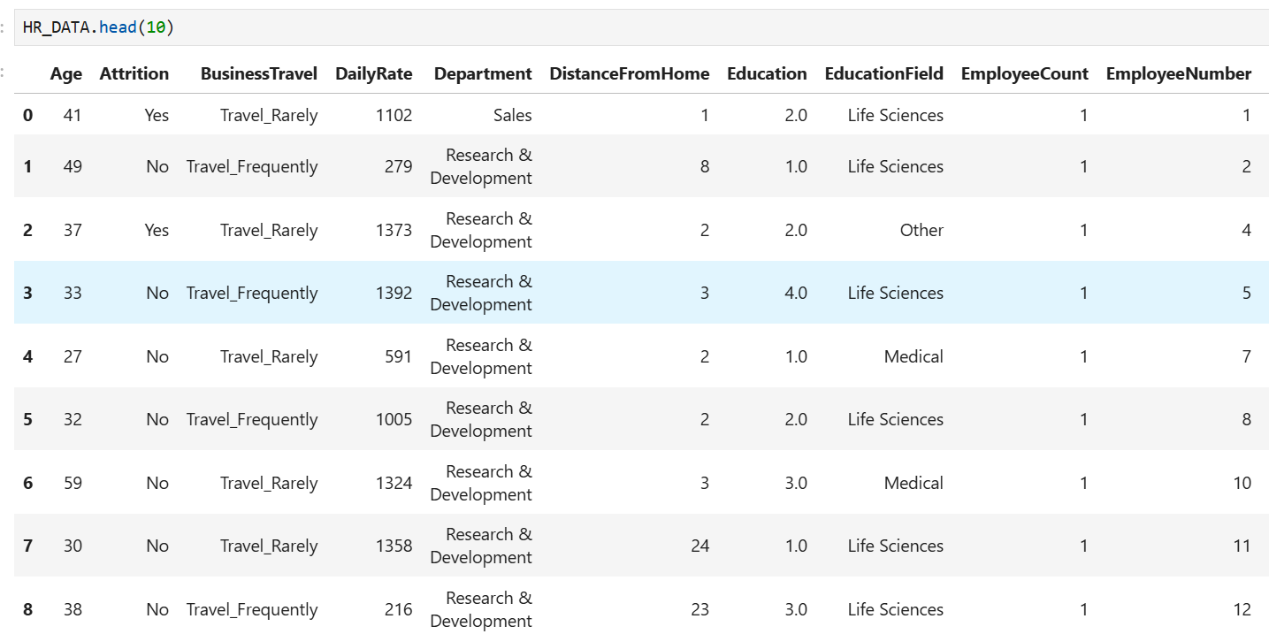
DATASET OVERVIEW

Slide 5
DATA CLEANING
Missing Values
Filled missing values in education, job satisfaction, environment satisfaction with mode.
Used median for age, income, years at company.
For categorical columns like job role, filled using most frequent category
Handling Inconsistent Values
Replaced 0 or negative values in income, years worked with NaN.
Standardized categorical labels (e.g., "Sales Exec" → "Sales Executive").
Converted binary fields (e.g., Attrition, OverTime) into Yes/No.
Outlier Detection & Treatment
Used boxplots & IQR to detect extreme salary/age outliers.
Winsorized extreme values in monthly income and years at company.
Ensured logical consistency (e.g., Years at company ≥ Years in current role).

Slide 6
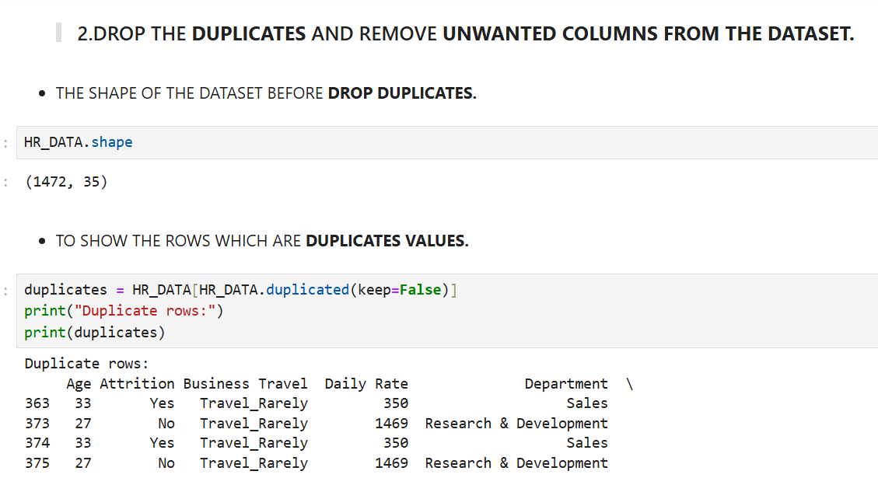
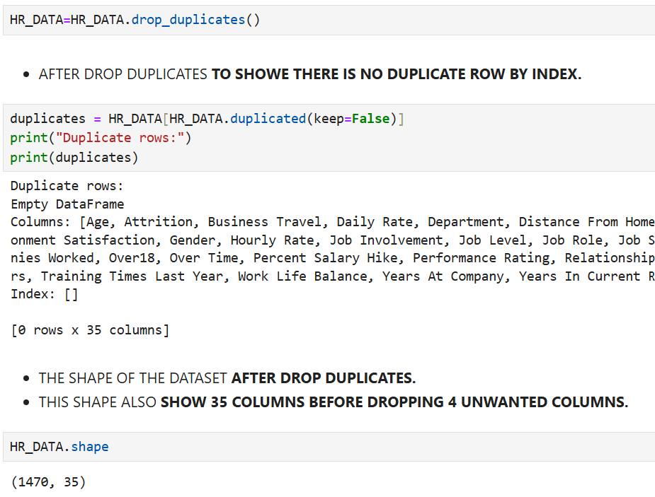
DROP DUPLICATES
BEFORE
AFTER

Slide 7
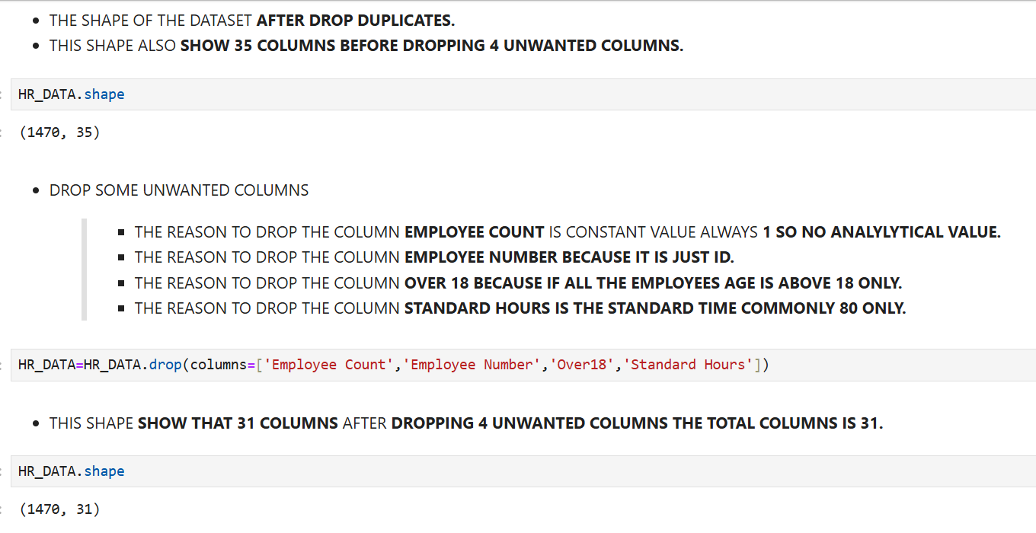
DROP COLUMNS

Slide 8
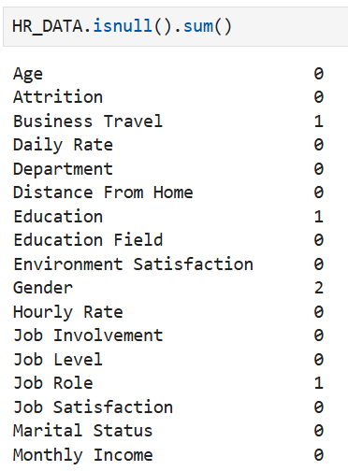
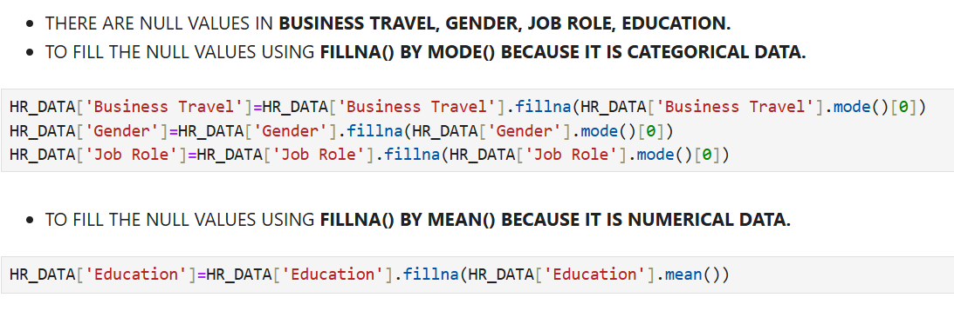
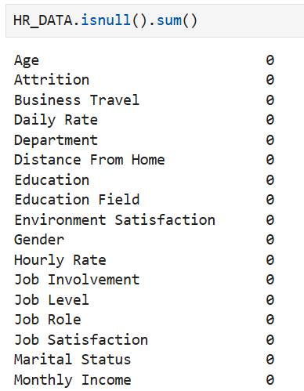
MISSING VALUES
BEFORE
AFTER

Slide 9
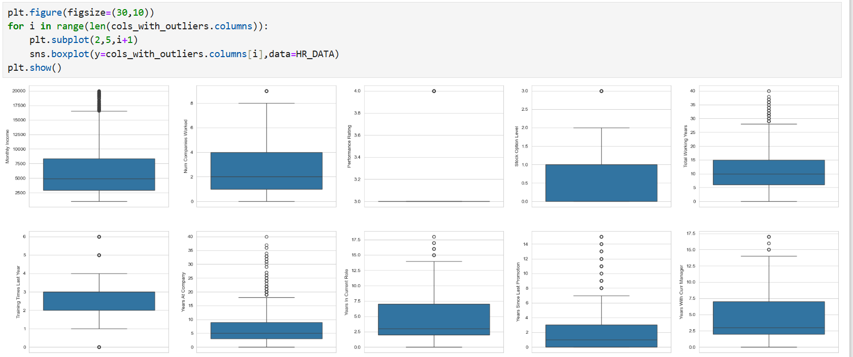
OUTLLIERS IN A DATASET

Slide 10
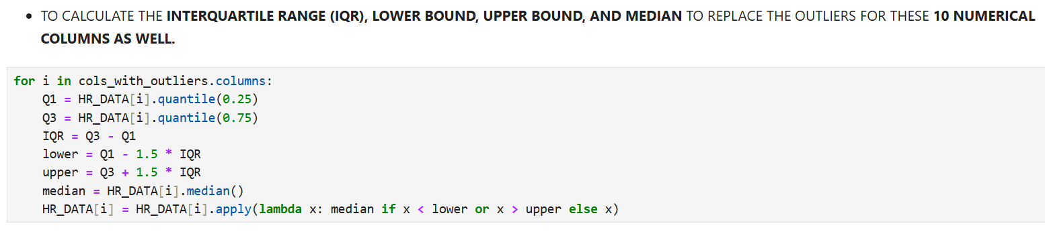
OUTLLIERS REPLACE

Slide 11
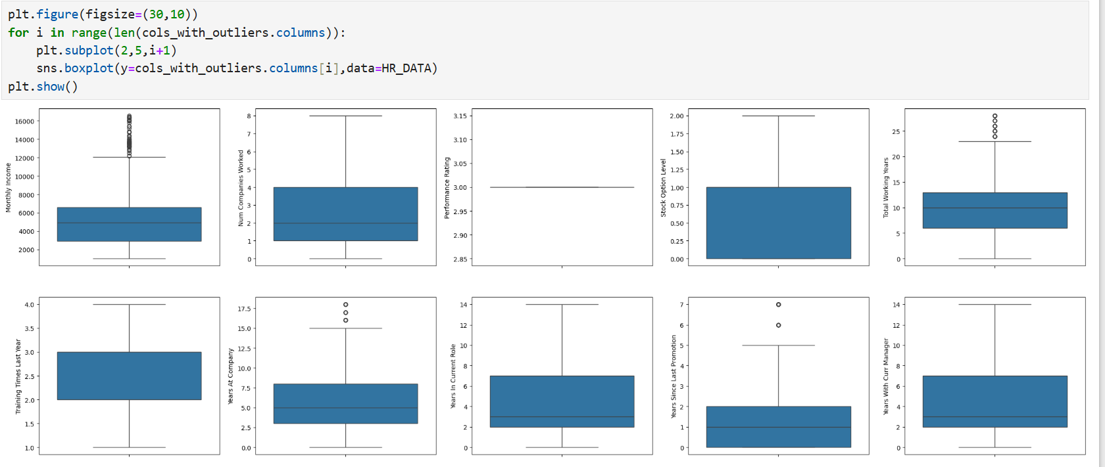
OUTLLIERS AFTER REPLACE

Slide 12
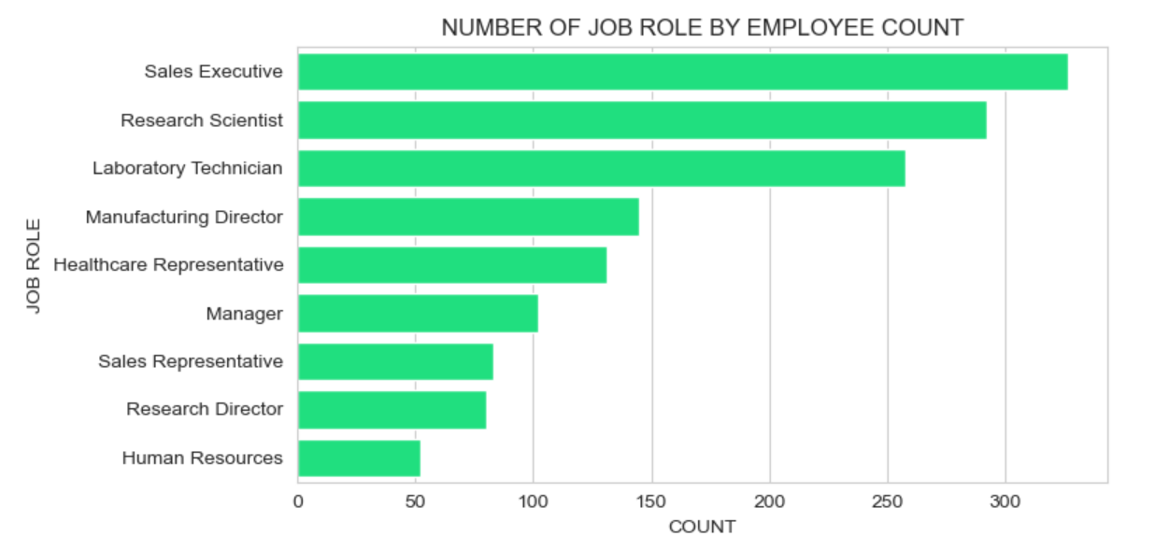
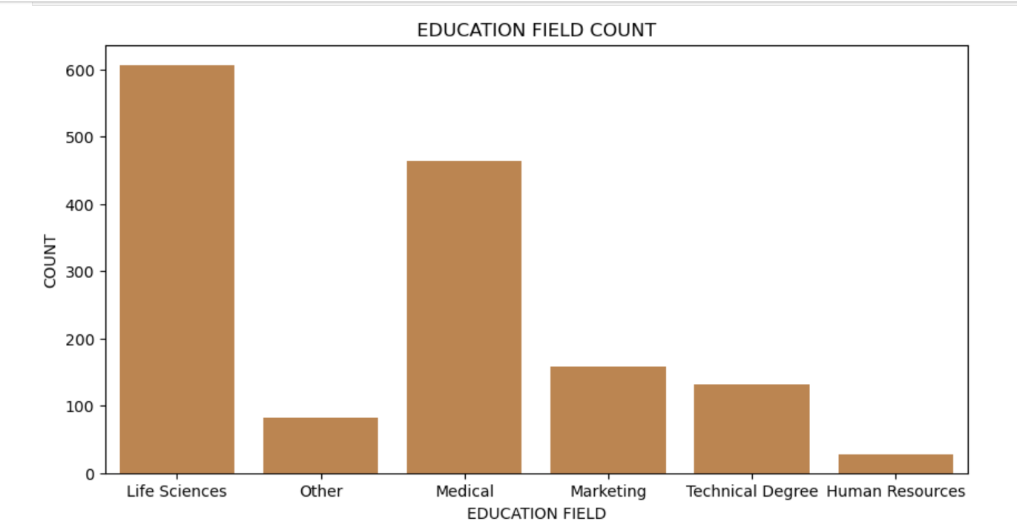
EXPLORATORY DATA ANALYSIS
1.UNIVARIATE ANALYSIS
NUMBER OF JOB ROLE BY EMPLOYEE COUNT
EDUCATION FIELD COUNT

Slide 13
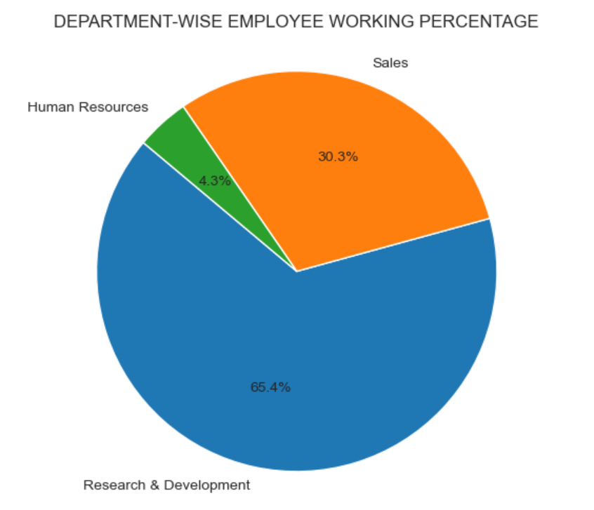
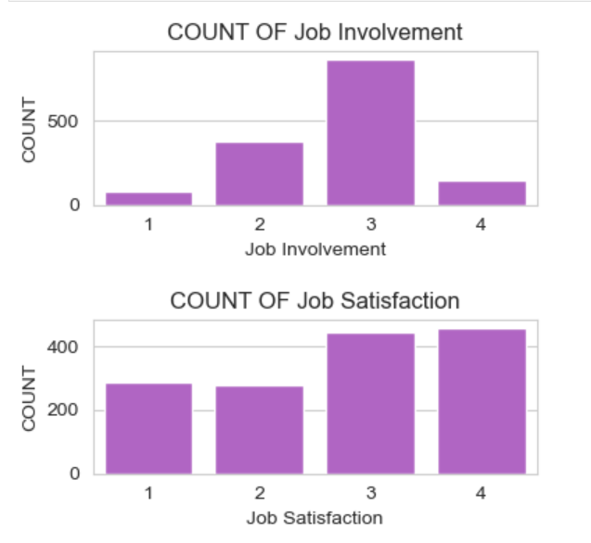
DEPARTMENT WISE EMPLOYEE WORKING PERCENTAG
COUNT OF JOB INVOLVEMENT
COUNT OF JOB SATISFACTION

Slide 14
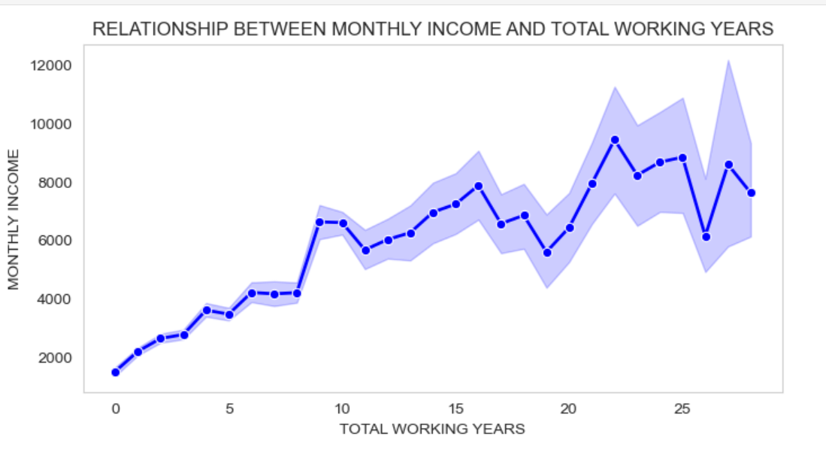
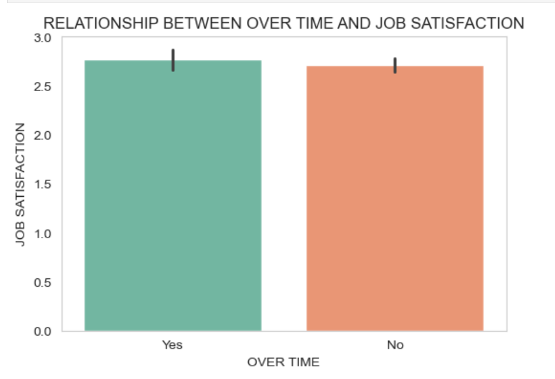
2. BIVARIATE CHART
LINE PLOT FOR MONTHLY INCOME VS TOTAL WORKING YEARS
BAR PLOT FOR OVER TIME VS JOB SATISFACTION

Slide 15
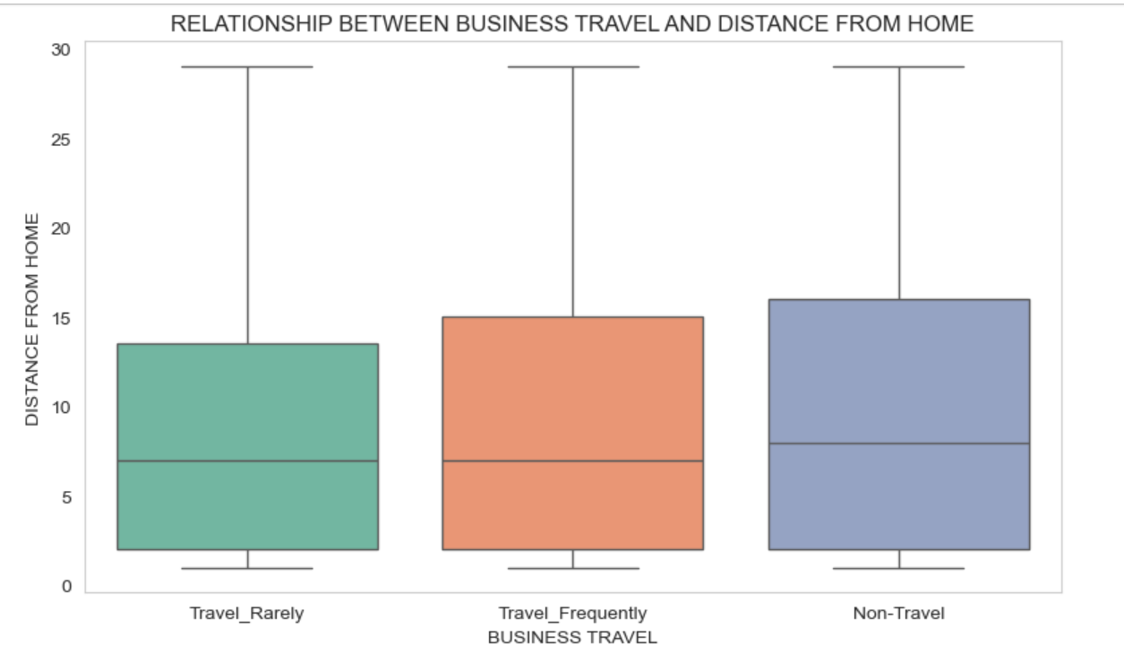
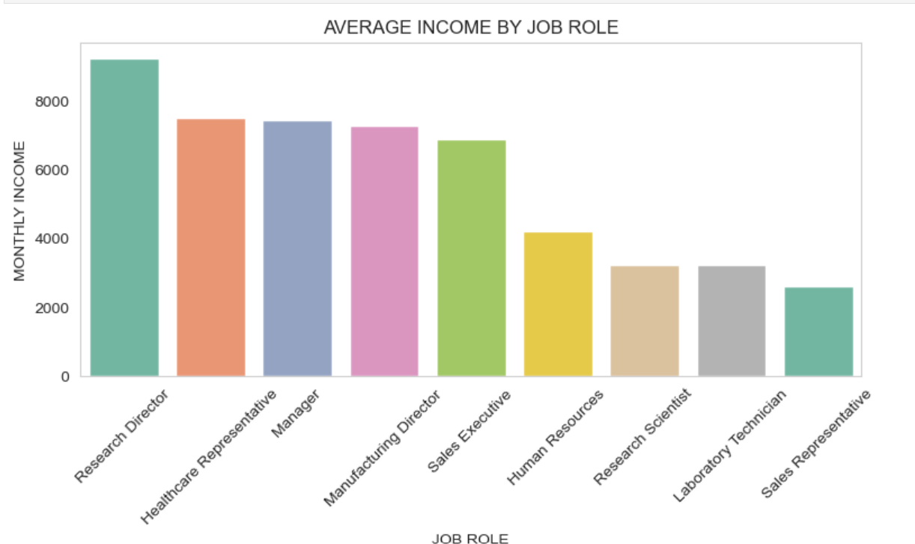
BOX PLOT FOR BUSINESS TRAVEL VS DISTANCE FROM HOME.
BAR PLOT FOR JOB ROLE VS MONTHLY INCOME.

Slide 16
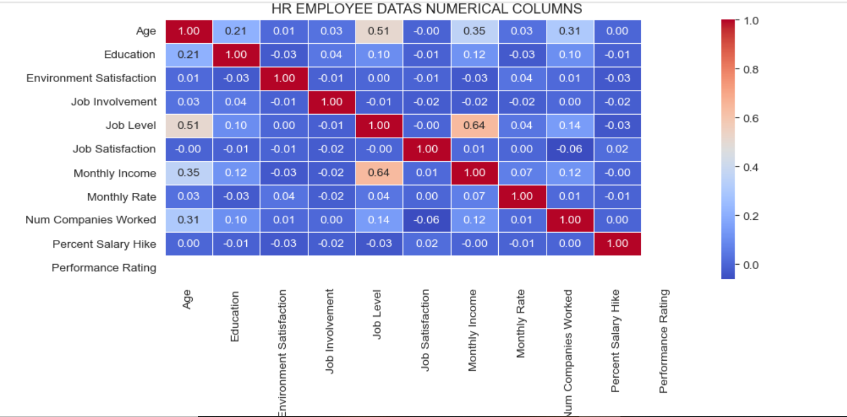
3.MULTIVARAITE ANALYSIS
HEAT MAP FOR HR EMPLOYEE DATA'S NUMERICAL COLUMNS

Slide 17
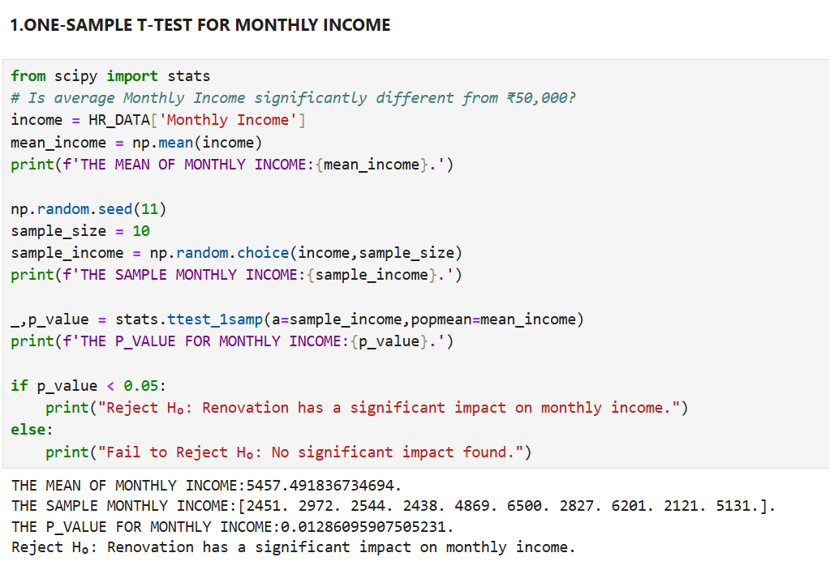
HYPOTHESIS TESTING
1.ONE-SAMPLE T-TEST FOR MONTHLY INCOME

Slide 18
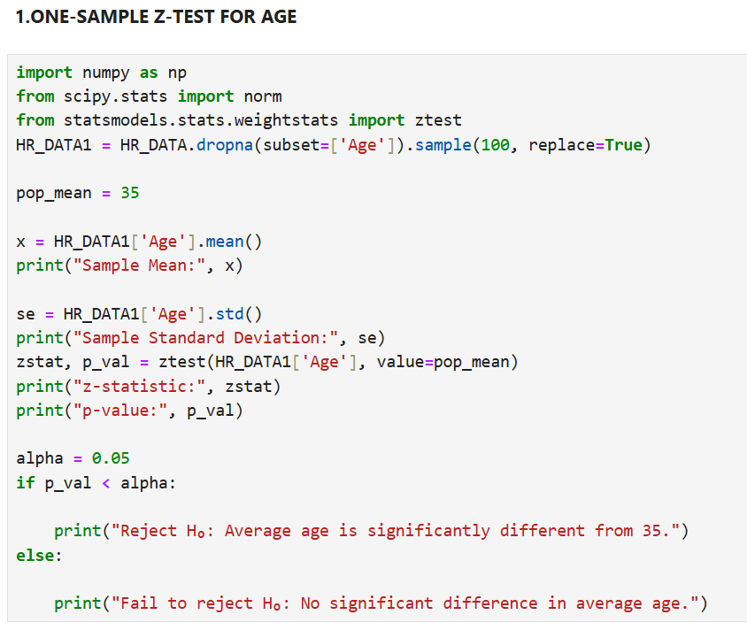
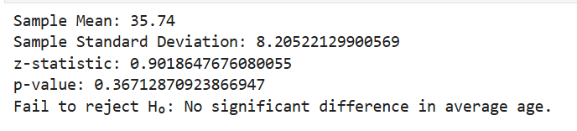
2.ONE-SAMPLE Z-TEST FOR AGE

Slide 19
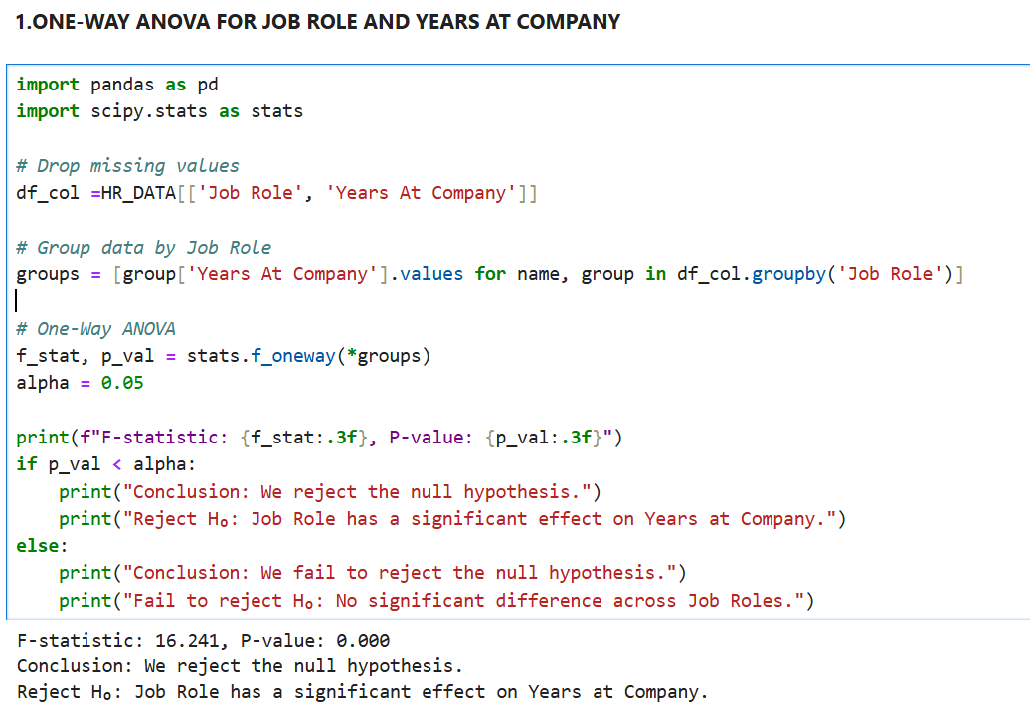
3.ONE-WAY ANOVA FOR JOB ROLE AND YEARS AT COMPANY

Slide 20
CONCLUSION
Data quality improved after removing duplicates, handling missing values,
and treating outliers—making analysis reliable.
Income and career progression are linked. Monthly income rises with job level and total working years.
Job role shows clear pay differences; departments vary in employee distribution and engagement metrics.
Hypothesis tests (t-test, z-test, ANOVA) indicate significant differences in key factors like income, age, and tenure across roles—useful for targeted
HR policies.

Slide 21
THANK YOU !

